Slide 1

Faculty Development Program (FDP)
Full Stack Development in JavaScript & TypeScript
Day 1: Foundations & Environment Setup

Slide 2
ABOUT ME
Mahesh Bodhgire
Senior Principal Engineer, MMC
12+ Years Industry Experience
Expertise: MEAN/MERN, TypeScript, Next.js

Slide 3
FDP AGENDA: DAY 1
Introduction to Full Stack Ecosystem and modern trends.
Mastering JavaScript ES6+ features and async patterns.
Transitioning to TypeScript for enterprise applications.
Professional Environment Setup and Tooling.
Version Control with Git & GitHub workflows.
Hands-on Exercises: Building the foundation.

Slide 4
WHAT IS FULL STACK?
Full stack development refers to the development of both front end (client side) and back end (server side) portions of an application.
Frontend: UI, UX, and Interaction.
Backend: Logic, APIs, and Auth.
Database: Persistence and Schema.
Deployment: Infrastructure.

Slide 5



FRONTEND TECHNOLOGIES
Core UI
Scalability
Styling
React.js for component-driven architecture and Next.js for SSR.
TypeScript for static typing and early error detection.
Utility-first CSS frameworks for rapid, responsive design.

Slide 6




BACKEND TECHNOLOGIES
Node.js & Express
Authentication & APIs
A non-blocking, event-driven runtime environment for building highly scalable network applications.
Implementing secure communication using JWT (JSON Web Tokens), OAuth2, and RESTful principles.
const app = express();

Slide 7



DATABASE TECHNOLOGIES
Relational (SQL)
Non-Relational (NoSQL)
PostgreSQL and MySQL. Structured data with strict schemas and complex relationships.
MongoDB. Flexible document-based storage designed for high-velocity data and horizontal scaling.
Use case: Financial apps, Inventory.
Use case: CMS, Real-time apps.

Slide 8



DEPLOYMENT PLATFORMS
Vercel
AWS
Render
Optimized for Frontend & Serverless.
Enterprise cloud infrastructure.
Simple hosting for Node.js backends.

Slide 9
MERN STACK FLOW
React: Interactive UI in the browser.
Express/Node: Handling API requests.
MongoDB: Cloud database storage.
The MERN stack provides a full JavaScript environment, allowing developers to share code between client and server.

Slide 10
WHY JAVASCRIPT?
Universal Language: One language for client, server, and mobile.
Vibrant Ecosystem: NPM contains over 2M+ packages and libraries.
High Performance: V8 Engine optimization and asynchronous execution.
Fast Iteration: Dynamic typing and hot-reloading allow rapid prototyping.

Slide 11
WHY TYPESCRIPT?
Type Safety: Eliminates whole classes of runtime errors at compile time.
IDE Support: Superior autocomplete, navigation, and refactoring tools.
Self-Documenting: Types provide explicit contracts for functions and components.
Maintainability: Essential for large-scale enterprise applications.

Slide 12
JAVASCRIPT EVOLUTION
ES5 (2009)
ES6+ (2015)
ESNext
Traditional "Vanilla" JS. CommonJS modules and callbacks.
Modern JS. Classes, arrow functions, and ES Modules.
Standardized annual updates. Async/await and Optional Chaining.

Slide 13

KEY ES6 FEATURES
Variable Scoping
Arrow Functions
let and const for block-level scoping vs var.
Concise syntax and lexical this binding.
Destructuring
Spread/Rest
Unpack values from arrays or properties from objects into distinct variables.
Copying arrays and objects easily using ... operator.

Slide 14






ASYNC PROGRAMMING
Callbacks
Promises
Async/Await
The "classic" way. Functions passed as arguments. High risk of "Callback Hell."
Objects representing the eventual completion of an async operation. .then()/.catch()
Syntactic sugar over promises. Makes asynchronous code look and behave like synchronous code.

Slide 15

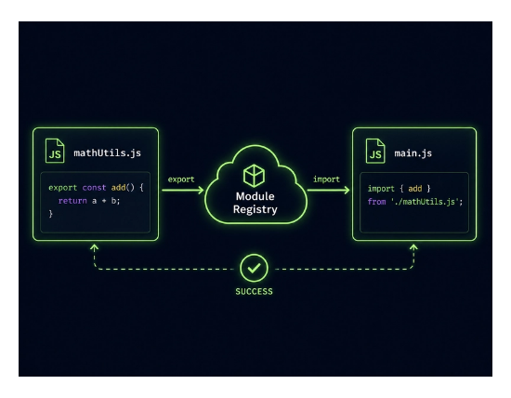

ES MODULES (ESM)
Standardized system for sharing code across files. Promotes a Modular Architecture.

Slide 16






TYPESCRIPT BASICS
Static Types
Interfaces
Generics
Define types for variables: string, number, boolean, any.
Define the "shape" of an object. Essential for API data contracts.
Create reusable components that work with a variety of types while maintaining safety.

Slide 17
JS VS TS: COMPARISON
Feature | JavaScript | TypeScript
Typing | Dynamic (Runtime) | Static (Compile-time)
Error Detection | During Execution | During Development
Maintainability | Difficult for large apps | Excellent for scalability
Tooling | Basic | Rich (Autocomplete/Refactor)

Slide 18



STANDARD PROJECT STRUCTURE
src/
components/ (UI Elements)
Modular Design
services/ (API Logic)
models/ (Types/Schemas)
Organizing code into logical folders ensures Separation of Concerns and makes the codebase easier to navigate and test.
controllers/ (Route Handlers)
utils/ (Helpers)

Slide 19
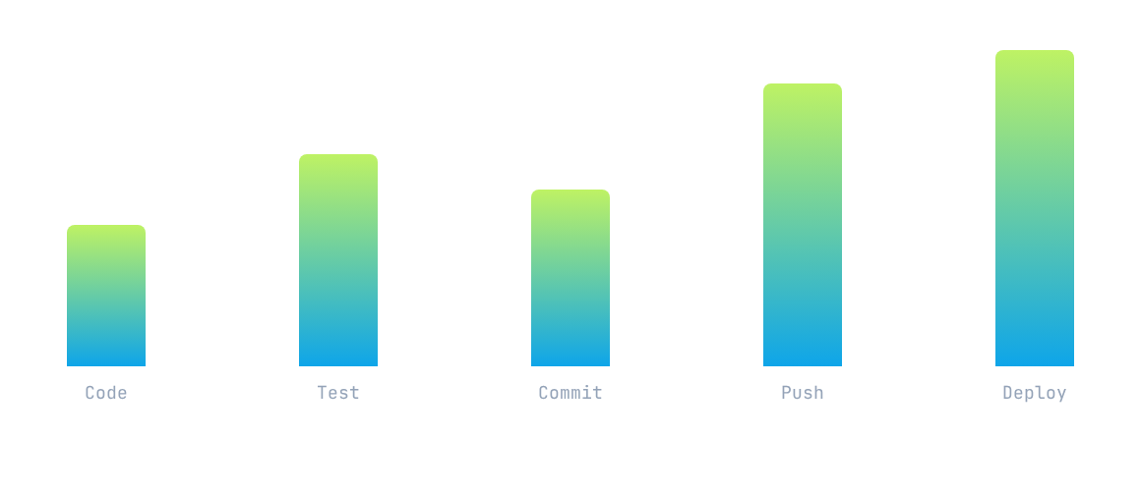
DEVELOPMENT WORKFLOW
Continuously delivering value through a robust CI/CD pipeline.

Slide 20





GIT BASICS
Repository
Commit
Branch
A central location for storing and managing code history.
Taking a "snapshot" of changes with a descriptive message.
Parallel version of a repository to develop features in isolation.

Slide 21


GITHUB COLLABORATION
Pull Requests (PR)
Code Reviews
The standard way to propose changes, discuss code, and merge into the main branch.
Maintaining high quality through peer feedback and automated checks before deployment.

Slide 22

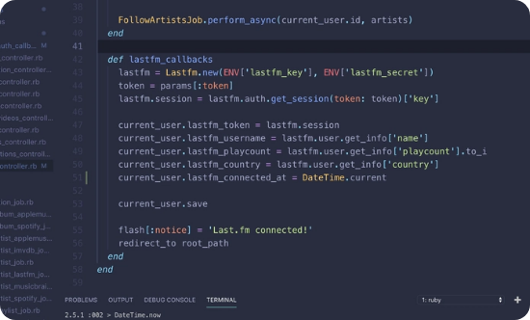
VS CODE TOOLING
ESLint: Static code analysis for finding patterns.
Prettier: Opinionated code formatter.
GitLens: Supercharged Git integration.
Thunder Client: Lightweight API client (REST/GraphQL).

Slide 23



INDUSTRY BEST PRACTICES
Clean Code
Modularity
Naming
Writing code for humans to read, not just machines to execute.
Single Responsibility Principle: One module, one purpose.
Using descriptive, consistent naming conventions (camelCase).

Slide 24
Day 1: Hands-on Overview
Setting up the dev environment, initializing a Git repo, and building a basic TS-powered Node.js API.

Slide 25
Questions?
Thank you

